Slide 1

Geography population case
studies

Slide 2
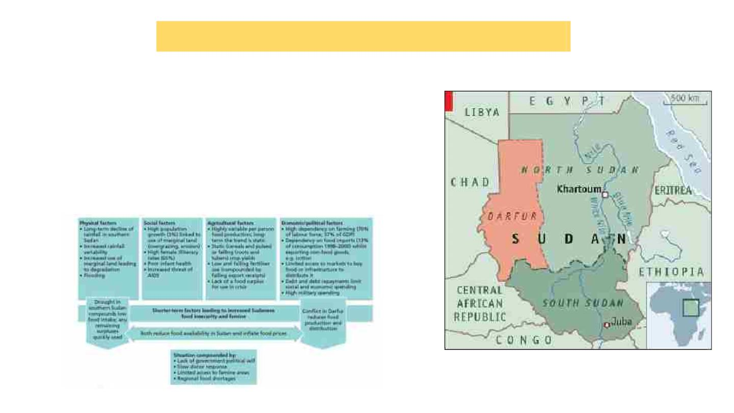
Sudan and South Sudan(Food shortage) .
●
●
●
Africa's largest country
Country located in northeastern Africa
The United Nations has estimated that up to 2 million people were
displaced by the civil war and more than70 OOO people died from hunger
and associated diseases.
●
the UN World Food Programme stopped deliveries of vital food supplies
because the situation was considered too dangerous for the drivers and
aid workers.

Slide 3
Reasons
●
-
-
South Sudan is currently in a war torn state:
1955 conflict between both Christian’s and Muslim’s
2 civil wars 6 years and at the end of 2005, peace agreement established
2018=new peace agreement
-
●
●
-
-
●
South Sudan is landlocked + experiences periods of high precipitation
Food insecurity
60% could face food insecurity from May/June 2020 in presence of a food assistant
2019 flooding increases weed, pests + diseases in crop field + limits forage available
South Sudan’s economy
-
-
-
75% of labor force take part in agricultural production
Main crop: sorghum, maize, millet (48% population relies) + majority is rainfed
37% of GDP on agriculture
-
80% live in farms
●
High population growth 3%

Slide 4
China- Population increase policy

Slide 5
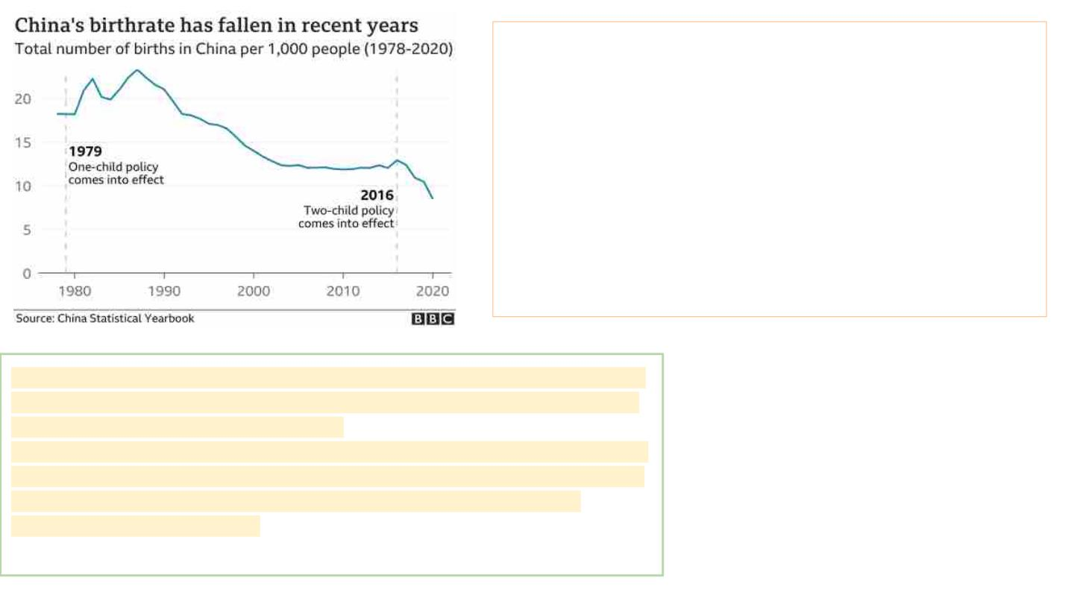
The census, released this month, showed that around 12 million
babies were born last year - a significant decrease from the 18
million in 2016, and the lowest number of births recorded since the
1960s.
The census was conducted in late 2020
●
The government's move in 2016 to allow couples to have
two children failed to reverse the country's falling birth rate
despite a two-year increase immediately afterwards.
As much as women living in expensive cities such as Beijing and Shanghai may
wish to delay or avoid childbirth, those in the countryside are likely to still follow
tradition and want large families, they say.
"If we free up policy, people in the countryside could be more willing to give birth
than those in the cities, and there could be other problems," a policy insider had
earlier told Reuters, noting that it could lead to poverty and employment
pressures among rural families.

Slide 6
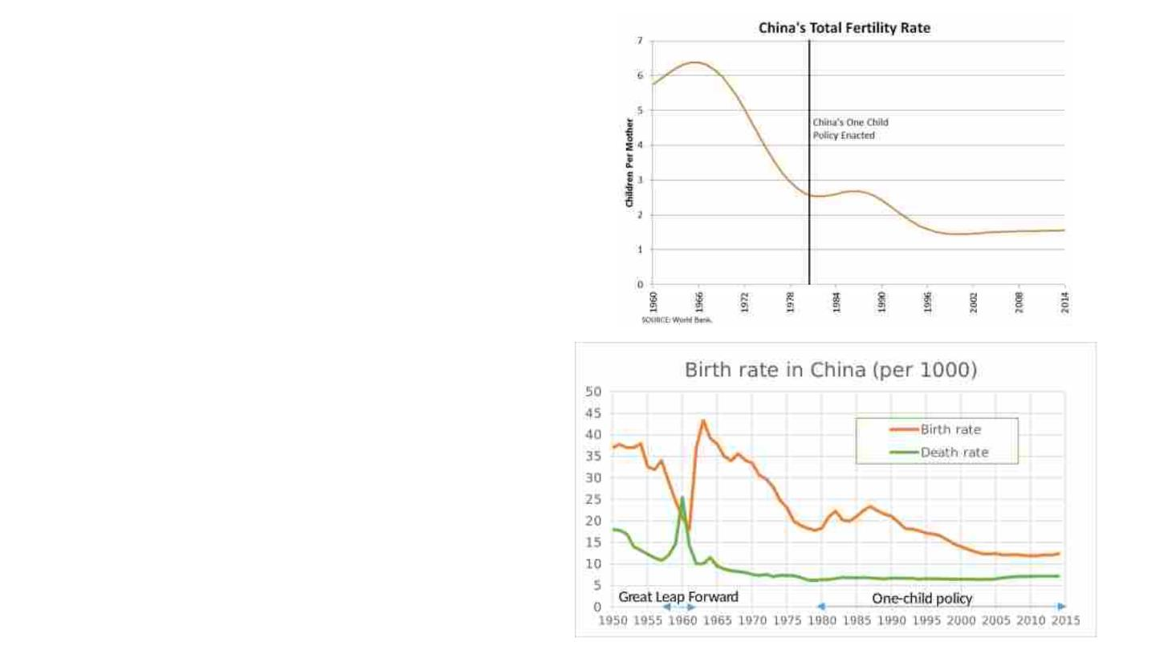
China - Population decline
Since 1979, China had been managing their
population by “One Child Policy”, “Family-
planning programme” was introduced by Deng
Xiaoping and was strictly enforced after the
population had increased to 969 million in 1979
from around 540 million in 1949, which caused a
suffering from poor. After using this method,
China’s natural increase /death rate and birth
rate/ slowly decreased, since people was not
that rich, which reminds us the GDP per person
was 183.98 USD, and annual growth rate was
10.8%. These means China was poorer than
India in 1979. As birth rate decrease, the total
fertility rate was decreased gradually.

Slide 7
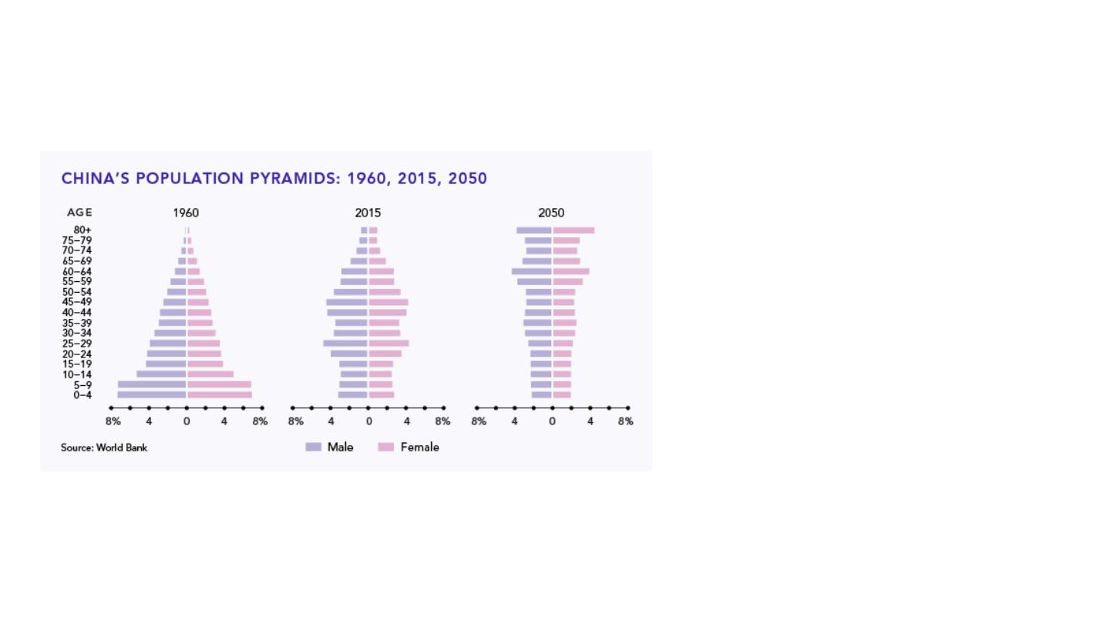
These factors led China’s population
structure to change. From the population
pyramid we can see that in 1960,
China’s structure was included more
child than workforce, which means
young family looked after their baby
instead of doing labour work. From
2015’s overview, percentage of children
decreased, yet as workforce class
increase, elder ones increased as well.
To estimate the future China, half of
China’s population will be elder people
by 2050.

Slide 8

Japan- Population ageing
● Over the age of 60- 33%
● Median age- 46 years old (World’s oldest)
● Peak- between 2005 and 2010 at 128 million
● Population projection- decline of 50 million by
the end of this century
● Total fertility rate- 1.4
● Under 15- 13% (World’s lowest)
● Workforce peak- 67.9million in 1998 and has
been in decline since

Slide 9
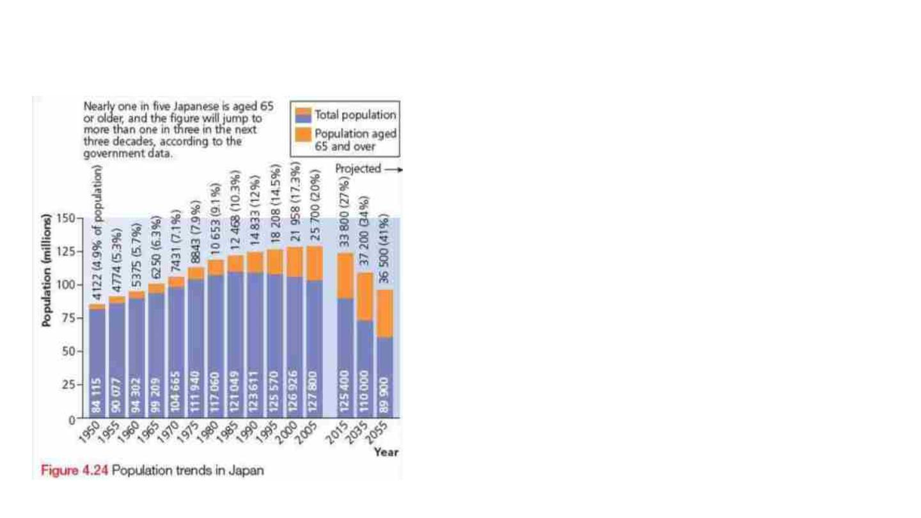
Issues and solutions
Issues:
- Economic and social challenge
- Economic burden on the existing
workforce
Solution: High labour-force participation
rate among the elderly. (Japanese men
work an average of 5 years after
mandatory retirement)

Slide 10

Economic and social challenges
● Positive attitudes towards older people-
National Respect the Aged day
● Number of old people living in care homes
or other welfare facilities is steadily rising→
more pressure placed on the country’s economy
● Cost of care- shared between the elderly
person, their family ad the government
● Social change- emergence of ageing as a
theme in films and books.

Slide 11

Possible solution
Possible solution (not possible): expanding
immigration and reduce the rising dependency
ratio.
● Foreigners make up- only 1% of Japan’s
labour force
● Legal immigration is practically impossible
(except for highly skilled ethnic Japanese
workers)

Slide 12
The Gambia-A country with a high young dependent population
● The smallest African country
● 95% of the population are Muslim
● Birth rate is high, on average each woman in her life time will have 5.67
children.
● Birth rate is 29.4 per 1000 population and for every 1000 children born 11
mothers will die in child birth.
● The life expectancy for women is 63.3 and for men 60.6.
● GDP per capita is $470.0
● The infant mortality rate is 60.2 per 1000.

Slide 13
Problems having a young population
● High dependency ratio
● Financial problem - not having enough money to feed and support the
growing family. Malnutrition
● Homes often don’t have electricity and are overcrowded.
● Poor sanitation
● Desertification of the forests(uses the wood for fires housing and selling). The
land left ends up as desert therefore making the temperature rise.
● Not enough education (teachers are poorly paid)

Slide 14
Responses to the problems
Contraception - There are now awareness campaigns and radio adverts
explaining about contraceptives
Health - Funding from Canada is used to provide free vaccination for children.
Managing Resources - The German government are funding a forest
management scheme. To plant new forests and educate the population on how to
look after and use the forests.
Education - More and more children are attending school.

Slide 15

Youthful Country Issues - Uganda
● Life Expectancy=63
● 2050 it will become the 6th most populous country in Africa
● In early stage 2 of DTM
● Mean age of birth for mothers: 19
● 25% urban population
● Population density increased from 122 inhabitants to 551 in 2050

Slide 16
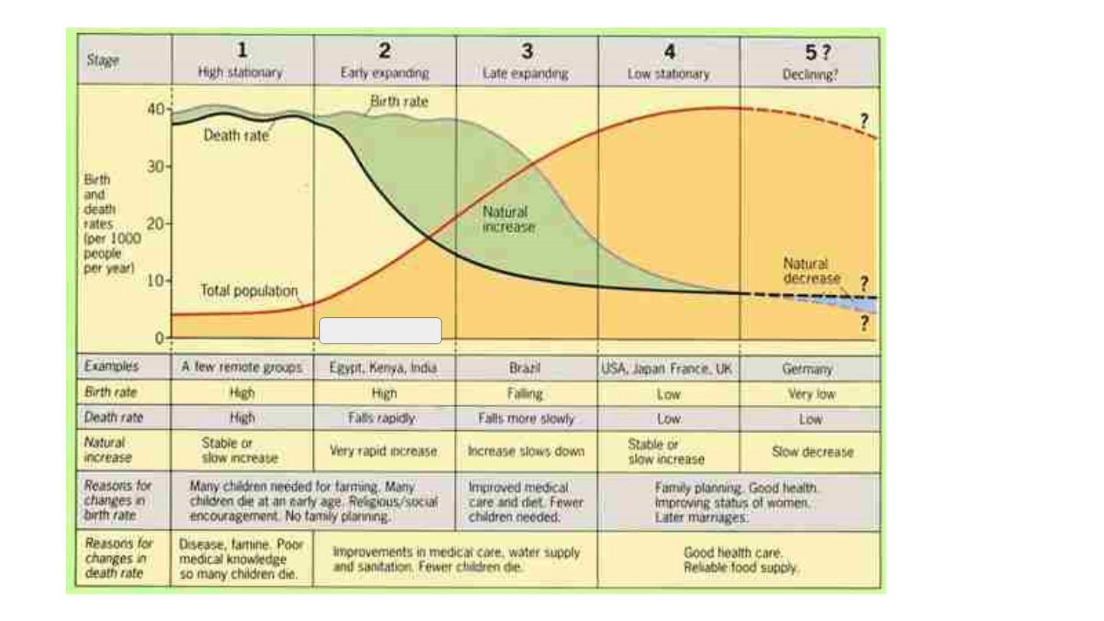
Uganda

